Slide 1
Medical Cost – Executive Presentation
Date: 08/2020
Presenter: Michelle Stevens

Slide 2
The correlation shows that the medical cost can increase for a serial of factors like Bmi, smoke or not, and age.
!
Through the increased of the Bmi and smoking patient and age, the Medical cost s will increase significatively
Bmi higher than 30 (obese) + smokers + older age has a higher chance to have a increased medical cost

Slide 3
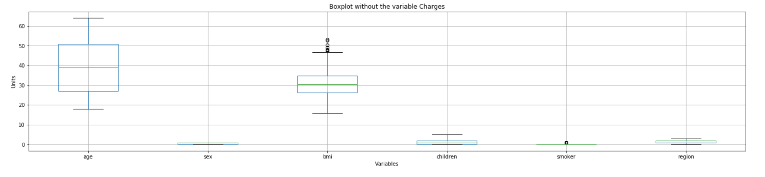
From the following charts we can see how the variables are match up with the higher medical Cost
Which are : Age, Bmi and Smoke

Slide 4
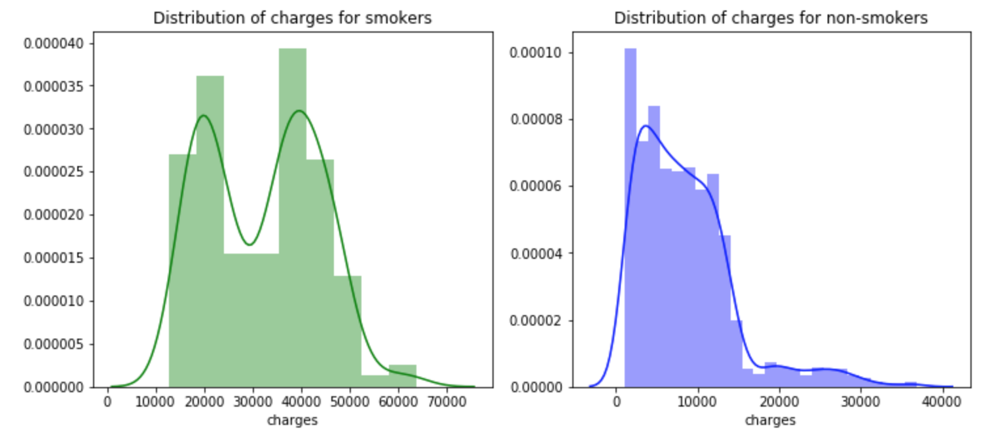
Charges x Smoker
The Distribution of charges and for smokers and non-smokers show us that Smokers tends to pay more for Medical cost

Slide 5
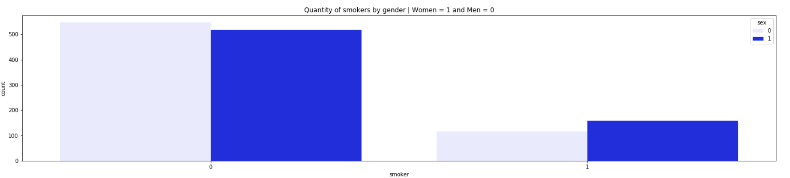
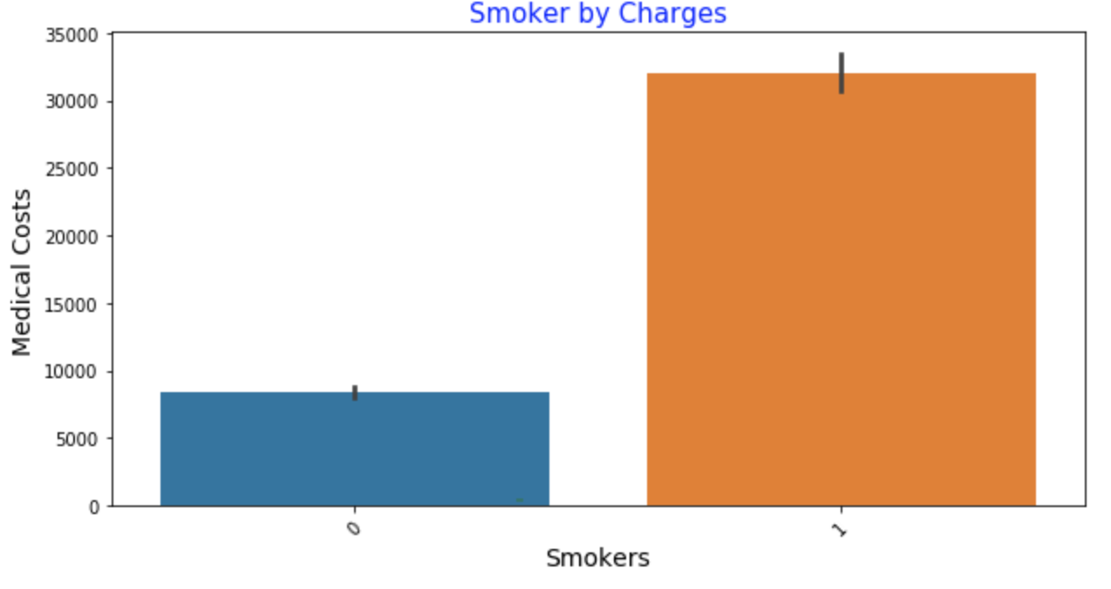
In the dataset there are 662 Male and 676 Female and most of the Male are Smokers and in the second graphic we can see that Smokers are also charged more for Medical Cost

Slide 6
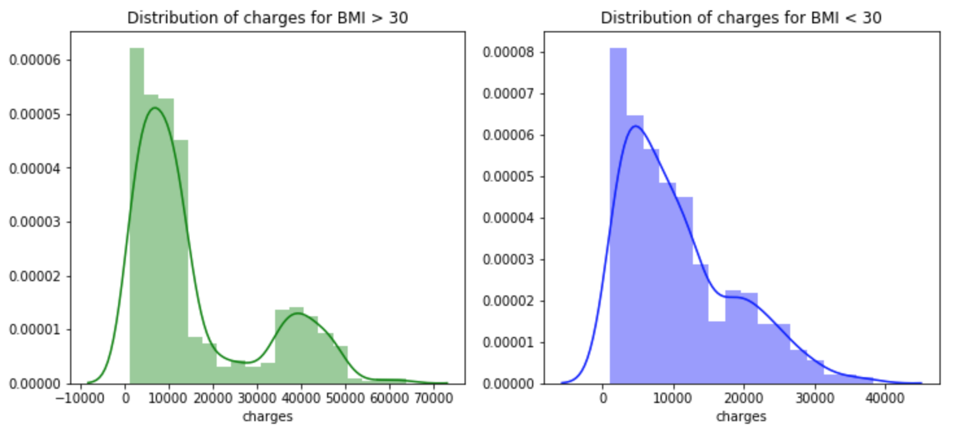
Higher Bmi than >30 is a big factor that also interfere in the medical cost
Bmi >30 , Male gender and Smoker are big factor in the medical area. Those are the three variables that influence in the Medical cost

